Slide 1
Monetary Policy According to HANK
Alice Shen, Kai Wakerman Powell and Chris Mornement

Slide 2
Overview
Chapter | Relevant section of paper | Presenter
Introduction | Introduction/key research question
 | Purpose and main contributions of paper
Model Basics
Findings
Discussion

Slide 3
Who the f**** is hank?

Slide 4
Paper summary
HANK stands for the Hetero Number Anagram Kapital….
Summarise from all others

Slide 5
Paper objective
The paper was written for XX.
AS

Slide 6
The HANK MODEL

Slide 7
HANK Basics
HANK builds on the New Keynesian model taught in class.
Additions include:
Xx

Slide 8
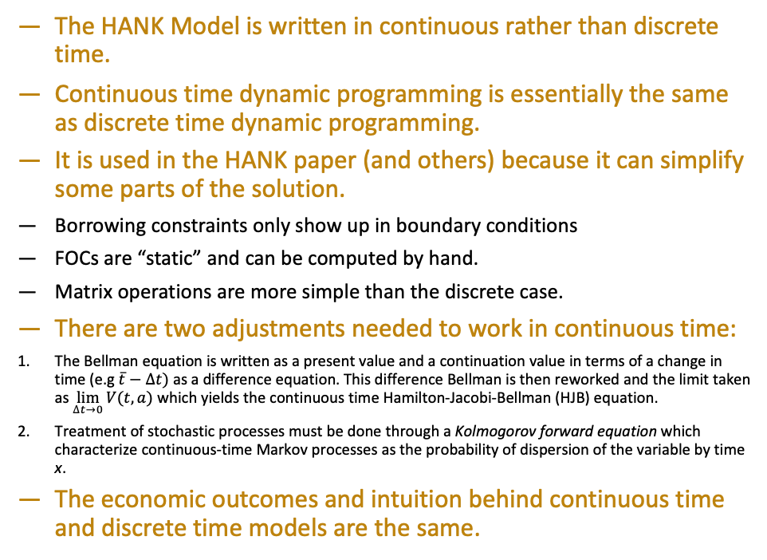
Stop, HANK time
The HANK Model is written in continuous rather than discrete time.
Continuous time dynamic programming is essentially the same as discrete time dynamic programming.
It is used in the HANK paper (and others) because it can simplify some parts of the solution.
Borrowing constraints only show up in boundary conditions
FOCs are “static” and can be computed by hand.
Matrix operations are more simple than the discrete case.
There are two adjustments needed to work in continuous time:
The Bellman equation is written as a present value and a continuation value in terms of a change in time (e.g $\overline{t}−∆t)$ as a difference equation. This difference Bellman is then reworked and the limit taken as $\lim_{∆t→0}{V(t,a)}$ which yields the continuous time Hamilton-Jacobi-Bellman (HJB) equation.
Treatment of stochastic processes must be done through a Kolmogorov forward equation which characterize continuous-time Markov processes as the probability of dispersion of the variable by time x.
The economic outcomes and intuition behind continuous time and discrete time models are the same.

Slide 9
HANK against the world
Comparing HANK against the data…

Slide 10
HANK Solution
HANK …

Slide 11
Policy Implications of HANK

Slide 12
Monetary transmission under HANK
Standard RANK models target the intertemporal substitution…
Indirect effects of unexpected rate cut (increase in labour demand) outweigh direct effects (from intertemporal substitution)
KWP

Slide 13
HANK and Taylor, sitting in a tree…
XX
KWP

Slide 14
Fiscal & monetary policy under HANK
Failure of Ricardian equivalence implies fiscal reaction to MP is key determinant of overall size of macroeconomic response
KWP

Slide 15
HANK living hand-to-mouth
XX

Slide 16
Discussion

Slide 17
Lucas vs HANK
XX

Slide 18
Micro-basis: Sticky prices
XX
CM

Slide 19
Micro-basis: Quadratic illiquid pricing
XX

Slide 20

THANK YOU

Slide 21
Thank you

Slide 22
References
Sergio Feijoo-Moreira, 2020. “Continuous-time dynamic programming – class notes”, Universidad Carlos III de Madrid
Greg Kaplan & Benjamin Moll & Giovanni L. Violante, 2018. "Monetary Policy According to HANK," American Economic Review, vol 108(3), pages 697-743.

